Slide 1

HEY Y’ALL...

Slide 2

HOW TO STAY ON TRACK AT WORK
1. MEET DEADLINES
2. PRUNE MEETINGS
3. STAY LOW-KEY

Slide 3



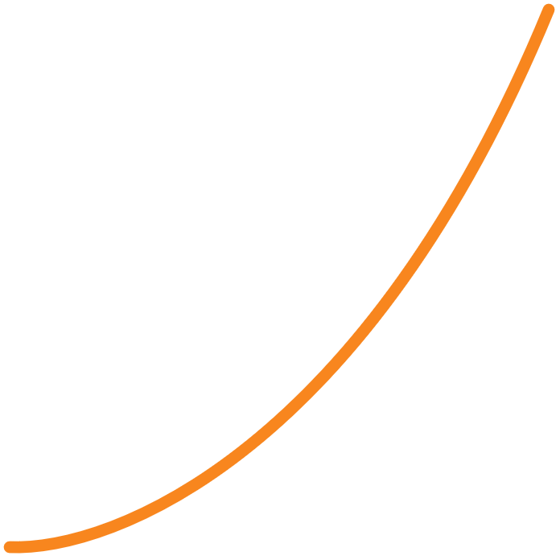





RESPECT THE DEADLINE.
PROJECT# | TEAM | DEADLINE | TIME THAT REMAINS | TASKS THAT REMAIN
46412321=091 | 616 | 30.10.2023 | 02:15:02 | 161
46409821=590 | 199999 | 10.11.2023 | 00:02:04 | 8
46417171=717 | 17 | 17.07.2017 | 17:17:17 | 17
46454356=077 | 9 | 18.15.1413 | 19:18:15 | 14131
46423454=432 | 12 | 15.11.9125 | 91:21:59 | 12159

Slide 4




AND REMEMBER, BEHAVE.
REPORT
RESET
RECHARGE
BEHAVE

